Slide 1
§10.4: Connectivity
In an undirected graph, a path of length n from u to v is a sequence of adjacent edges going from vertex u to vertex v.
A path is a circuit if u=v.
A path pass through the vertices or traverses the edges.
A path is simple if it contains no edge more than once.

Slide 2
Paths in Directed Graphs
Same as in undirected graphs, but the path must go in the direction of the arrows.

Slide 3
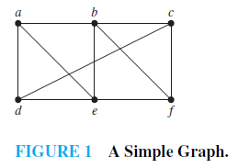
Example
a,d,c,f,e is a path.
d,e,c,a is not a path.
b,c,f,e,b is a circuit.
a,b,e,d,a,b is not a simple path.

Slide 4
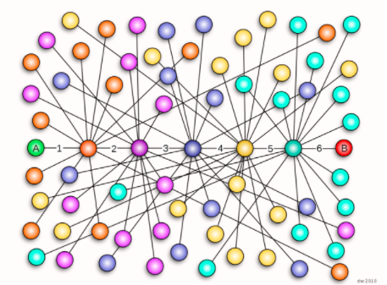
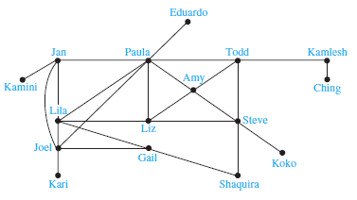
Paths in Acquaintanceship Graphs
Six Degrees of Separation by John Guare
Notes:
Some have speculated that almost every pair of people in the world are linked by a small chain of no more than six, or maybe even, five people. The play Six Degrees of Separation by John Guare is based on this notion.

Slide 5
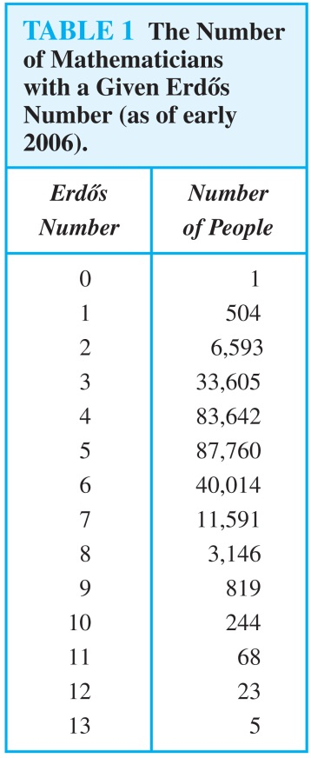
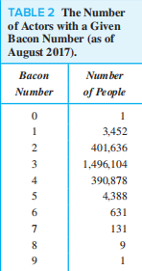
Paths in Collaboration Graphs
academic collaboration graph of people
Erdos number
In the Hollywood graph
Bacon number
Notes:
Example: Erdős numbers. In a collaboration graph, two people a and b are connected by a path when there is a sequence of people starting with a and ending with b such that the endpoints of each edge in the path are people who have collaborated.
In the academic collaboration graph of people who have written papers in mathematics, the Erdős number of a person m is the length of the shortest path between m and the prolific mathematician Paul Erdős.
To learn more about Erdős numbers, visit
http://www.ams.org/mathscinet/collaborationDistance.html
In the Hollywood graph, two actors a and b are linked when there is a chain of actors linking a and b, where every two actors adjacent in the chain have acted in the same movie.
The Bacon number of an actor c is defined to be the length of the shortest path connecting c and the well-known actor Kevin Bacon. (Note that we can define a similar number by replacing Kevin Bacon by a different actor.)
The oracle of Bacon web site http://oracleofbacon.org/how.php provides a tool for finding Bacon numbers.

Slide 6
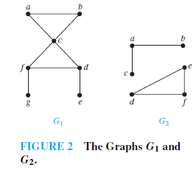
Connectedness
An undirected graph is connected if there is a path between every pair of distinct vertices in the graph.
Example 4, p717

Slide 7
Theorem: There is a simple path between every pair of distinct vertices of a connected undirected graph.

Slide 8
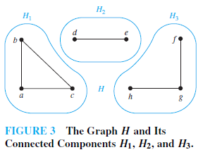
A Connected component of a graph G is a connected subgraph of G that is not a proper subgraph of another connected subgraph of G.
Example 5, p717
Connected Components of Call Graph

Slide 9
A cut vertex or cut edge (bridge) separates 1 connected component into 2 if removed.

Slide 10

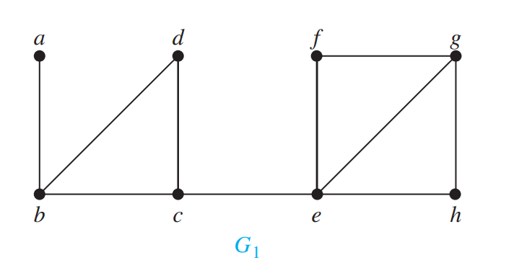
多选题
1分
Find the cut vertices in the graph G₁
A
a
B
b
C
c
D
d
E
e
提交

Slide 11
多选题
1分
Find the cut edges in the graph G₁
A
a,b
B
b,d
C
c,e
D
f,e
E
e,h
提交

Slide 12
Vertex Connectivity
Nonseparable graphs
Connected graphs without cut vertices are called nonseparable graphs
Vertex cut
A subset V′ of the vertex set V of G = (V, E) is a vertex cut, or separating set, if G − V′ is disconnected.

Slide 13
Vertex Connectivity
Vertex connectivity
We define the vertex connectivity of a noncomplete graph G, denoted by 𝜅(G), as the minimum number of vertices in a vertex cut.
0 ≤ 𝜅(G) ≤ n − 1 if G has n vertices
𝜅(K_{n}) = n − 1
𝜅(G) = 0 if and only if G is disconnected or G = K₁
A graph is k-connected (or k-vertex-connected), if 𝜅(G) ≥ k.
Note that if G is a k-connected graph, then G is a j-connected graph for all j with 0 ≤ j ≤ k.

Slide 14
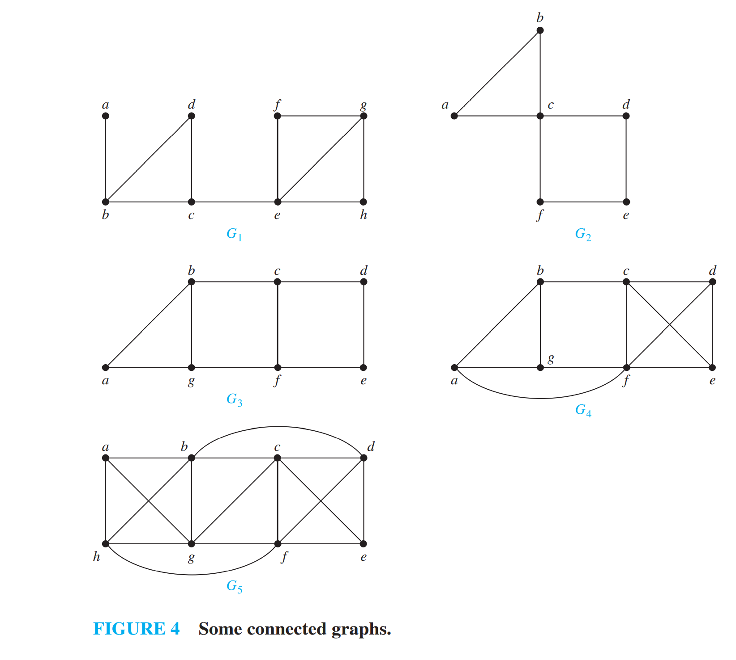
多选题
1分
Determine which graphs in Figure 4 have a vertex connectivity of 2.
A
G₁
B
G₂
C
G₃
D
G₄
E
G₅
提交

Slide 15
Edge Connectivity
Edge cut
A set of edges E′ is called an edge cut of G if the subgraph G − E ′ is disconnected.
Edge connectivity
The edge connectivity of a graph G, denoted by 𝜆(G), is the minimum number of edges in an edge cut of G.
𝜆(G) = 0 if G is not connected or G has a single vertex.
If G is a graph with n vertices, then 0 ≤ 𝜆(G) ≤ n − 1.
𝜆(G) = n − 1 where G is a graph with n vertices if and only if G = K_{n}.

Slide 16
多选题
1分
Determine which graphs in Figure 4 have a edge connectivity of 2.
A
G₁
B
G₂
C
G₃
D
G₄
E
G₅
提交

Slide 17
AN INEQUALITY FOR VERTEX CONNECTIVITY AND EDGE CONNECTIVITY
G = (V, E) is a noncomplete connected graph with at least three vertices
𝜅(G) ≤ min_{v∈V} deg(v)
𝜆(G) ≤ min_{v∈V} deg(v)
G = (V, E) is a noncomplete connected graph
𝜅(G) ≤ 𝜆(G) ≤ min_{v∈V} deg(v)

Slide 18
APPLICATIONS OF VERTEX AND EDGE CONNECTIVITY
Reliability of networks
vertex connectivity router
edge connectivity fiber optic links
Highway network
vertex connectivity intersections
edge connectivity roads

Slide 19
Directed Connectedness
A directed graph is strongly connected if there is a path from a to b and from b to a whenever a and b are vertices in the graph.
It is weakly connected if there is a path between every two vertices in the underlying undirected graph.
Note strongly implies weakly but not vice-versa.

Slide 20
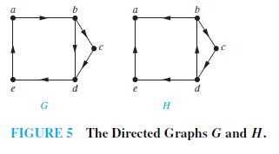
Example 11
Strongly connected components or strong components

Slide 21
Example 12
The Strongly Connected Components of the web graph
Notes:
Recall that at any particular instant the web graph provides a snapshot of the web, where vertices represent web pages and edges represent links. According to a 1999 study, the Web graph at that time had over 200 million vertices and over 1.5 billion edges. (The numbers today are several orders of magnitude larger.)
The underlying undirected graph of this Web graph has a connected component that includes approximately 90% of the vertices.
There is a giant strongly connected component (GSCC) consisting of more than 53 million vertices. A Web page in this component can be reached by following links starting in any other page of the component. There are three other categories of pages with each having about 44 million vertices:
pages that can be reached from a page in the GSCC, but do not link back.
pages that link back to the GSCC, but can not be reached by following links from pages in the GSCC.
pages that cannot reach pages in the GSCC and can not be reached from pages in the GSCC.

Slide 22
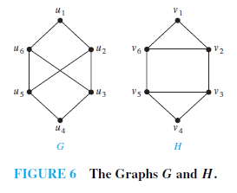
Paths & Isomorphism
Note that connectedness, and the existence of a circuit or simple circuit of length k are graph invariants with respect to isomorphism.
Example 13

Slide 23
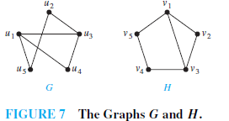
Use paths to find mappings
Example 14,P723
the paths u₁, u₄, u₃, u₂, u₅ in G and v₃, v₂, v₁, v₅, v₄ in H

Slide 24
Counting Paths by Adjacency Matrices
Let A be the adjacency matrix of graph G.
The number of paths of length k from v_{i} to v_{j} is equal to (A^{k})_{i,j}.
The notation (M)_{i,j} denotes m_{i,j} where [m_{i,j}] = M.

Slide 25
Proof by mathematical induction
Basis Step: By definition of the adjacency matrix, the number of paths from v_{i} to v_{j} of length 1 is the (i,j)th entry of A.
Inductive Step: For the inductive hypothesis, we assume that that the (i,j)th entry of A^{r} is the number of different paths of length r from v_{i} to v_{j}.
Because A^{r+1} = A^{r} A, the (i,j)th entry of A^{r+1} equals b_{i1}a_{1j} + b_{i2}a_{2j} + ⋯ + b_{in}a_{nj}, where b_{ik} is the (i,k)th entry of A^{r}. By the inductive hypothesis, b_{ik} is the number of paths of length r from v_{i} to v_{k}.
A path of length r + 1 from v_{i} to v_{j} is made up of a path of length r from v_{i} to some v_{k} , and an edge from v_{k} to v_{j}. By the product rule for counting, the number of such paths is the product of the number of paths of length r from v_{i} to v_{k} (i.e., b_{ik} ) and the number of edges from from v_{k} to v_{j} (i.e, a_{kj}). The sum over all possible intermediate vertices v_{k} is b_{i1}a_{1j} + b_{i2}a_{2j} + ⋯ + b_{in}a_{nj} .

Slide 26
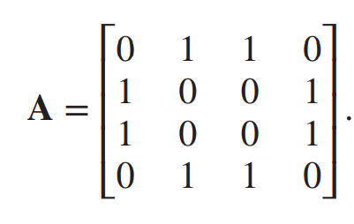

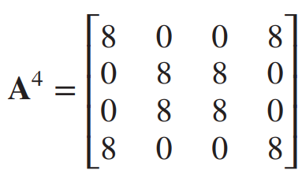
Example 15
How many paths of length four are there from a to d in the simple graph G in Figure 8?

Slide 27
Homework
14,28,36,60

